Slide 1
Rounding errors
Estimation and rounding

Slide 2
how to use Oak lessons

Slide 3
I can appreciate the impact of rounding errors when using a calculator (or other technology), and the way that these can be compounded to result in large inaccuracies.

Slide 4
Significant figures are the digits in a number that contribute to the accuracy of the number.
The first significant figure is the first non-zero digit.
Number lines can be used to round to one significant figure.
Example
6523 = 7000 (1 s.f.)
6523 = 6500 (2 s.f.)
6523 = 6520 (3 s.f.)

Slide 5

Rounding errors
Number lines
The impact of rounding errors

Slide 6
Number lines
We round in everyday life to make a calculation easier. Sometimes we are given rounded values and must identify the range of values of the unrounded number.

Slide 7
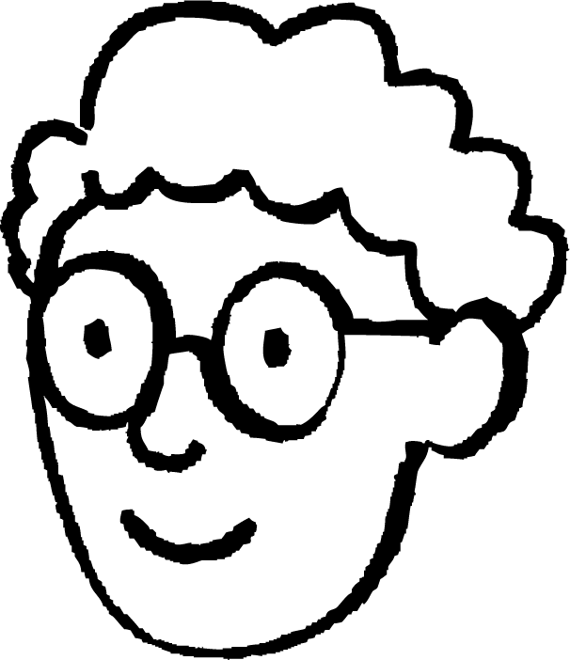
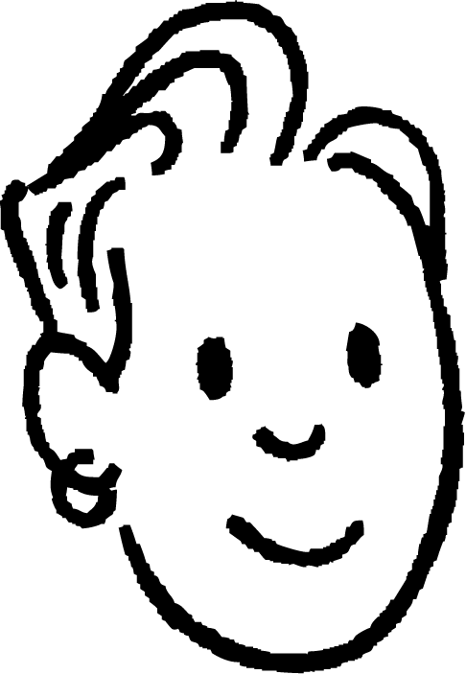
Number lines
For example, 250 has been rounded to the nearest 10.
What integer values could the unrounded number be?
Can you see a way to identify all the unrounded integers that give 250 when rounded to the nearest 10?
Alex
Sam
245
247
253
254
240
250
260

Slide 8
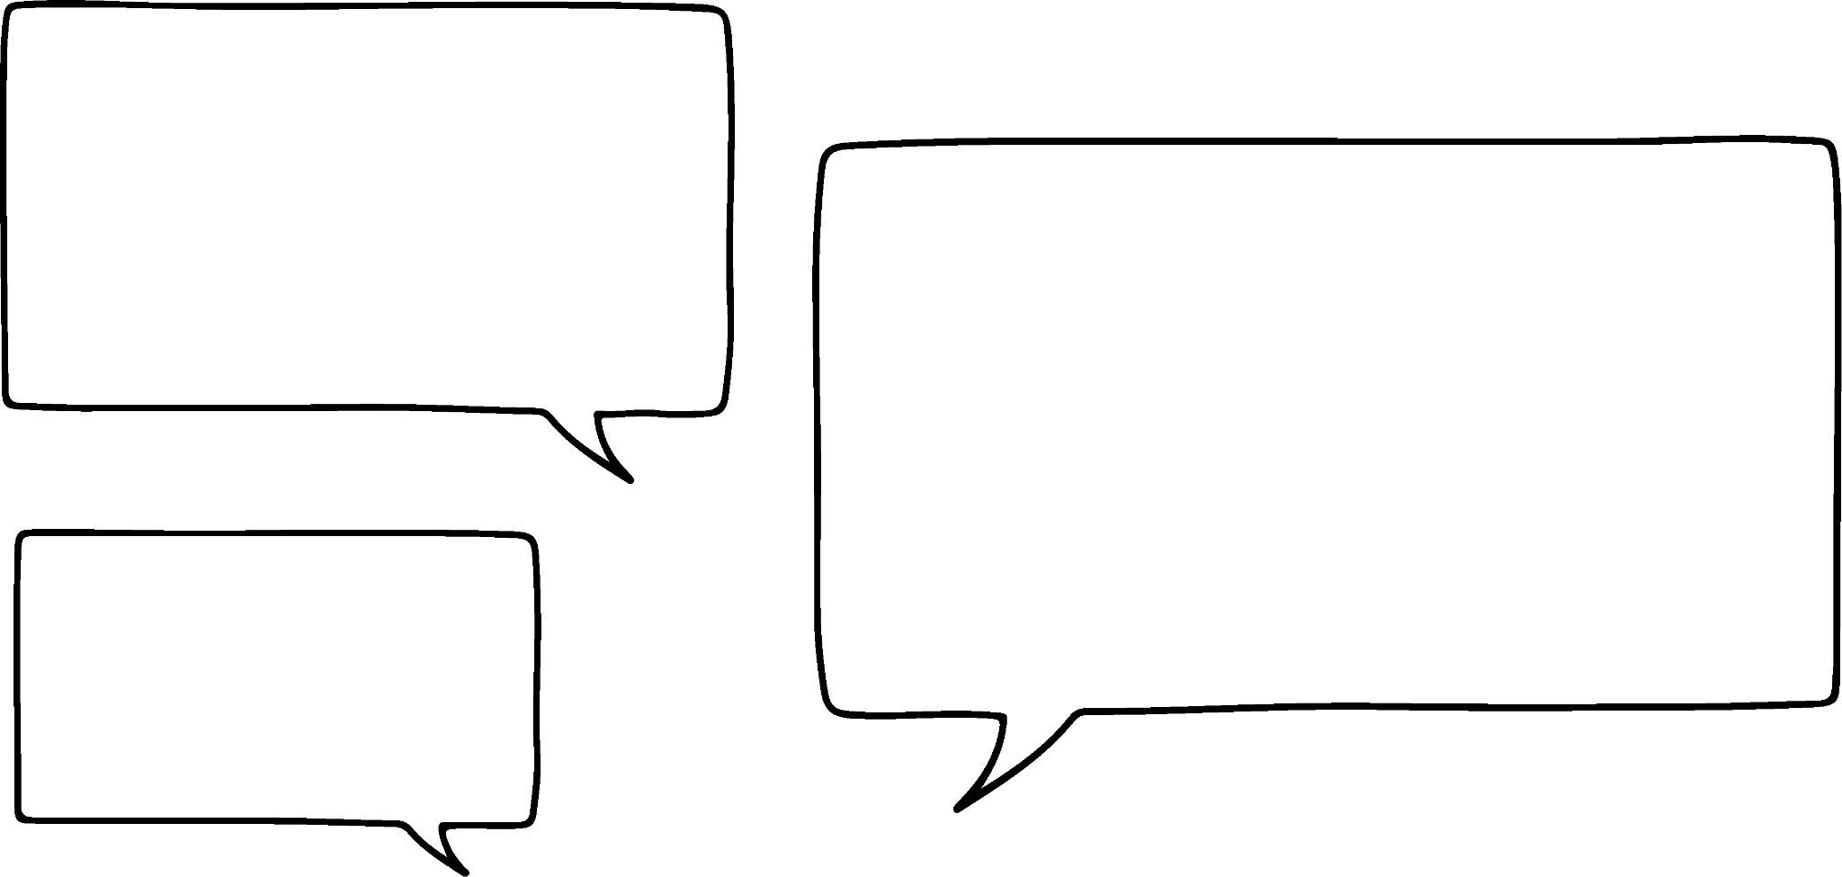
Number lines
For example, 250 has been rounded to the nearest 10.
What integer values could the unrounded number be?
245, 246, 247, 248, 249, 250, 251, 252, 253, 254
I see! Identifying the middle on the line segments on the number line will help me see the range of values for the unrounded number.
Nice strategy!
Alex
Sam
245
254
240
250
260

Slide 9
Number lines
What are the smallest and largest integers that when rounded to the nearest 50 give 300?
As the degree of accuracy is the nearest 50, + and − 50 either side of the 300.
I will start by putting 300 in the middle.
Alex
Sam
250
300
350

Slide 10
Number lines
What are the smallest and largest integers that when rounded to the nearest 50 give 300?
So 275 is the smallest integer and 324 is the largest integer
I know this must be 275.
This is 325 but this rounds up to 350 so I use 324
Alex
Sam
275
325
250
300
350

Slide 11
Number lines
Work out the largest and smallest unrounded integers. You can use the number line if it helps.
430 rounded to the nearest 10
6800 rounded to the nearest 100
160 rounded to the nearest 20
420
430
440
425 is the smallest integer
434 is the largest integer
6750 is the smallest integer
6849 is the largest integer
6700
6800
6900
150 is the smallest integer
169 is the largest integer
140
160
180

Slide 12
Number lines
Work out the largest and smallest unrounded integers. You can use a number line if it helps.
300 rounded to the nearest 10
300 rounded to the nearest 100
300 rounded to the nearest 50

Slide 13
Number lines
Work out the largest and smallest unrounded integers. You can use a number line if it helps.
d) 640 rounded to the nearest 10
e) 3000 rounded to the nearest 100
f) 50 rounded to the nearest 50

Slide 14
Number lines
2) Work out the unknown number. Draw number lines to help.
rounded to the nearest 10
140 rounded to the nearest
rounded to the nearest
715 is the smallest integer
724 is the largest integer
130 is the smallest integer
149 is the largest integer
875 is the smallest integer
924 is the largest integer

Slide 15
Number lines
3) In a school, the headteacher says there are 480 pupils rounded to the nearest 10. What is the largest number of pupils in the school?
4) An advert says 56 000 people use their product rounded to the nearest 1000. What is the least amount of people who use their product?

Slide 16
Number lines
Work out the largest and smallest unrounded integers. You can use a number line if it helps.
300 rounded to the nearest 10
300 rounded to the nearest 100
300 rounded to the nearest 50
290
300
310
295 is the smallest integer
304 is the largest integer
250 is the smallest integer
349 is the largest integer
200
300
400
250
300
350
275 is the smallest integer
324 is the largest integer

Slide 17
Number lines
Work out the largest and smallest unrounded integers. You can use a number line if it helps.
d) 640 rounded to the nearest 10
e) 3000 rounded to the nearest 100
f) 50 rounded to the nearest 50
630
640
650
635 is the smallest integer
644 is the largest integer
2900
3000
3100
2950 is the smallest integer
3049 is the largest integer
0
50
100
25 is the smallest integer
74 is the largest integer

Slide 18
Number lines
2) Work out the unknown number. Draw number lines to help.
720 rounded to the nearest 10
140 rounded to the nearest 20
900 rounded to the nearest 50
715
725
715 is the smallest integer
724 is the largest integer
710
720
730
130
150
130 is the smallest integer
149 is the largest integer
120
140
160
875
925
875 is the smallest integer
924 is the largest integer
850
900
950

Slide 19
Number lines
3) In a school, the headteacher says there are 480 pupils rounded to the nearest 10. What is the largest number of pupils in the school?
4) An advert says 56 000 people use their product rounded to the nearest 1000. What is the least amount of people who use their product?
The largest number of pupils in the school would be 484
The smallest number of people would be 55 500

Slide 20
Rounding errors
Number lines
The impact of rounding errors

Slide 21
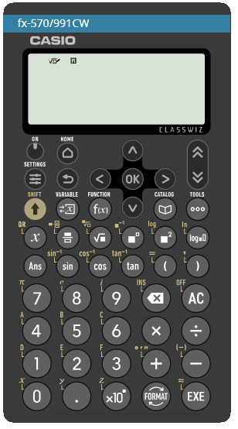
The impact of rounding errors
There are lots of different scientific calculators, but all have very similar functionality and notation.
They are fantastic instruments and incredibly powerful.
Usually when there are errors with a calculation, it is not the fault of the calculator.

Slide 22
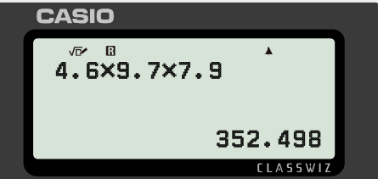
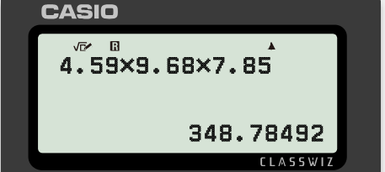
The impact of rounding errors
For example, here are two calculations done on a calculator.
Can you explain why Laura and Jun get different answers?
Work out the volume of this cuboid to 1 decimal place.
4.59 m
7.85 m
9.68 m
Laura
Jun
“The volume is 352.5 m³ (1 d.p.)”
“The volume is 348.8 m³ (1 d.p.)”

Slide 23
The impact of rounding errors
For example, here are two calculations done on a calculator.
Can you explain why Laura and Jun get different answers?
Work out the volume of this cuboid to 1 decimal place.
4.59 m
7.85 m
9.68 m
Laura
Laura
She has rounded too early. It is important to keep the values as accurate as possible and round at the end of the calculation.
“The volume is 352.5 m³ (1 d.p.)”

Slide 24

The impact of rounding errors
The area of the circular garden is 120 m².
A rectangular summer house has been placed in the garden.
Work out the remaining area that is left to 1 d.p.
8.24 m
7.15 m
Try this question and round answers to calculations to 3 s.f. and then finally round to 1 d.p.
8.24 × 7.15 = 58.916
= 58.9 (3 s.f.)
120 - 58.9 = 61.1 cm²
Jun

Slide 25
The impact of rounding errors
The area of the circular garden is 120 m².
A rectangular summer house has been placed in the garden.
Work out the remaining area that is left to 1 d.p.
8.24 m
7.15 m
Now let’s try it using the ANS button, then round the final answer to 1 d.p.
Jun

Slide 26
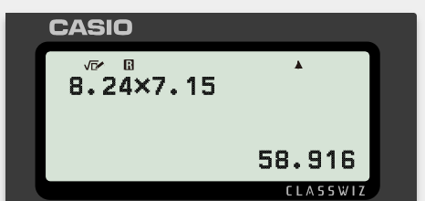
The impact of rounding errors
The area of the circular garden is 120 m².
A rectangular summer house has been placed in the garden.
Work out the remaining area that is left to 1 d.p.
8.24 m
7.15 m
Input the area of the rectangle and press EXE
Jun

Slide 27
The impact of rounding errors
The area of the circular garden is 120 m².
A rectangular summer house has been placed in the garden.
Work out the remaining area that is left to 1 d.p.
8.24 m
7.15 m
The answer on the screen is now saved as ANS, as it is the last answer on the screen.
Jun

Slide 28
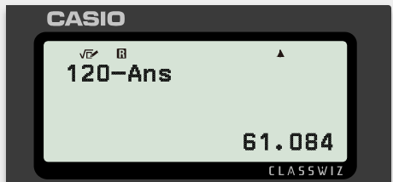
The impact of rounding errors
The area of the circular garden is 120 m².
A rectangular summer house has been placed in the garden.
Work out the remaining area that is left to 1 d.p.
8.24 m
7.15 m
Now press 120 − ANS, then EXE
Jun

Slide 29
The impact of rounding errors
The area of the circular garden is 120 m².
A rectangular summer house has been placed in the garden.
Work out the remaining area that is left to 1 d.p.
8.24 m
7.15 m
The same answer.
8.24 × 7.15 = 58.916
= 58.9 (3 s.f.)
120 - 58.9 = 61.1 m²
Jun

Slide 30
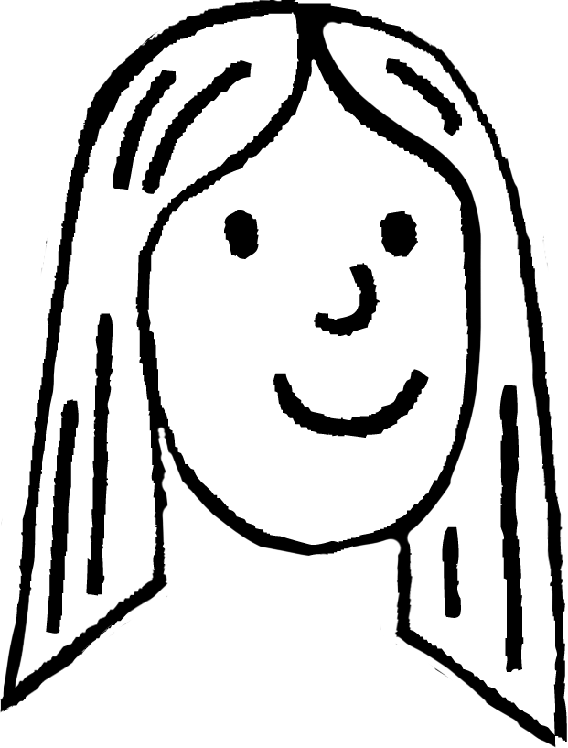
The impact of rounding errors
Great! But how do I show my working out when I am using the ANS button?
Laura
Good question, use an ellipsis “ …” to show you have used the unrounded number
8.24 × 7.15 = 58.916
120 - 58.9 … = 61.1 m²
8.24 × 7.15 = 58.916
= 58.9 (3 s.f.)
120 - 58.9 = 61.1 m²
Jun

Slide 31
The impact of rounding errors
Which of the following working out shows the correct answer to this question? Explain the errors.
“The area of the pentagon is 14 m². A triangle has been cut out. Work out the remaining area to 1 d.p.”
2.98 m
3.54 m
Area of triangle:
0.5 × 3 × 4 = 6
Remaining area:
14 − 6 =
8.0 m² (1 d.p.)
Area of triangle:
0.5 × 2.98 × 3.54 =
5.2746 m²
Remaining area:
14 − 5.27 … =
8.7 m² (1 d.p.)
Area of triangle:
0.5 × 2.98 × 3.54 =
5.28 m² (3 s.f.)
Remaining area:
14 − 5.28 =
8.7 m² (1 d.p.)

Slide 32
The impact of rounding errors
Which of the following working out shows the correct answer to this question? Explain the errors.
“The area of the pentagon is 14 m². A triangle has been cut out. Work out the remaining area to 1 d.p.”
2.98 m
3.54 m
Area of triangle:
0.5 × 3 × 4 = 6
Remaining area:
14 − 6 =
8.0 m² (1 d.p.)
They have rounded each measurement to 1 s.f. before any calculating.

Slide 33
The impact of rounding errors
Which of the following working out shows the correct answer to this question? Explain the errors.
“The area of the pentagon is 14 m². A triangle has been cut out. Work out the remaining area to 1 d.p.”
2.98 m
3.54 m
This calculation and working out is correct.
Good use of the ellipsis!
Area of triangle:
0.5 × 2.98 × 3.54 =
5.2746 m²
Remaining area:
14 − 5.27 … =
8.7 m² (1 d.p.)

Slide 34
The impact of rounding errors
Which of the following working out shows the correct answer to this question? Explain the errors.
“The area of the pentagon is 14 m². A triangle has been cut out. Work out the remaining area to 1 d.p.”
2.98 m
3.54 m
Area of triangle:
0.5 × 2.98 × 3.54 =
5.28 m² (3 s.f.)
Remaining area:
14 − 5.28 =
8.7 m² (1 d.p.)
Although the answer is correct, there is an error in their working out.
They have incorrectly rounded to 3 significant figures.
It should be 5.27 to 3 s.f.

Slide 35
The impact of rounding errors
1) Here is a plot of land. Explain if and where students have lost accuracy and resulted in an incorrect answer when finding the area of the rectangle to 2 d.p.
1.628 km
2.685 km
Aisha
1.628 × 2.685 = 4.38 km² (2 d.p.)
Laura
16.28 × 26.85 = 437.118
= 437.12 km² (2 d.p.)
Jun
1.628 × 2.685 = 4.37 km² (2 d.p.)
Andeep
1.63 × 2.69 = 4.38 km² (2 d.p.)

Slide 36
The impact of rounding errors
2) A circular sheet of metal has an area of 25 m². It gets two square patches with lengths 2.6574 m cut from it using a laser cutter.
Which pupil has correctly worked out the unpatched area to 2 d.p.? Explain the errors from the other pupils.
Aisha
Area of squares:
2 × 2.6574 × 2.6574
= 14.1 (1 d.p.)
Remaining area:
25 − 14.1 =
10.90 m² (2 d.p.)
Lucas
Area of squares:
2 × 2.6574 × 2.6574
= 14.12 (2 d.p.)
Remaining area:
25 − 14.12 =
10.88 m² (2 d.p.)
Laura
Area of squares:
2 × 2.6574 × 2.6574
= 14.123 …
Remaining area:
25 − 14.123 … =
10.88 m² (2 d.p.)

Slide 37
The impact of rounding errors
1) Here is a plot of land. Explain if and where students have lost accuracy and resulted in an incorrect answer when finding the area of the rectangle to 2 d.p.
1.628 km
2.685 km
Aisha
1.628 × 2.685 = 4.38 km² (2 d.p.)
1.628 × 2.685 = 4.37118
Aisha has incorrectly rounded her answer.
Jun
1.628 × 2.685 = 4.37 km² (2 d.p.)
This is correctly rounded and Jun has used the accurate measurements given.
Andeep has rounded the measurements before calculating the area. This has resulted in a loss of accuracy.
Andeep
1.63 × 2.69 = 4.38 km² (2 d.p.)

Slide 38
The impact of rounding errors
1) Here is a plot of land. Explain if and where students have lost accuracy and resulted in an incorrect answer when finding the area of the rectangle to 2 d.p.
1.628 km
2.685 km
Laura has incorrectly written her values. She has changed the place value of the digits and so her answer is far too big.
Laura
16.28 × 26.85 = 437.118
= 437.12 km² (2 d.p.)

Slide 39
The impact of rounding errors
2) A circular sheet of metal has an area of 25 m². It gets two square patches with lengths 2.6574 m cut from it using a laser cutter.
Which pupil has correctly worked out the unpatched area to 2 d.p.? Explain the errors from the other pupils.
Aisha
Area of squares:
2 × 2.6574 × 2.6574
= 14.1 (1 d.p.)
Remaining area:
25 − 14.1 =
10.90 m² (2 d.p.)
Aisha has rounded too early.
She rounded her first calculation to 1 d.p. which has meant she has struggled to give the correct accurate answer to 2 d.p.

Slide 40
The impact of rounding errors
2) A circular sheet of metal has an area of 25 m². It gets two square patches with lengths 2.6574 m cut from it using a laser cutter.
Which pupil has correctly worked out the unpatched area to 2 d.p.? Explain the errors from the other pupils.
Lucas
Area of squares:
2 × 2.6574 × 2.6574
= 14.12 (2 d.p.)
Remaining area:
25 − 14.12 =
10.88 m² (2 d.p.)
Lucas has answered the question correctly.
He did round early, but stated it to 2 d.p. which resulted in less error loss.

Slide 41
The impact of rounding errors
2) A circular sheet of metal has an area of 25 m². It gets two square patches with lengths 2.6574 m cut from it using a laser cutter.
Which pupil has correctly worked out the unpatched area to 2 d.p.? Explain the errors from the other pupils.
Laura
Area of squares:
2 × 2.6574 × 2.6574
= 14.123 …
Remaining area:
25 − 14.123 … =
10.88 m² (2 d.p.)
Laura has used the ellipsis to show she is using the ANS button on her calculator.

Slide 42
Rounding errors
We round in everyday life to make calculations easier. Sometimes we are given rounded values and must identify the range of values of the unrounded number.
Number lines can help us identify the smallest and largest integers of unrounded numbers.
Scientific calculators are fantastic instruments and incredibly powerful. We have to be careful when to round and choosing our degree of accuracy. Sometimes when there are errors with a calculation, it is not the fault of the calculator.

Slide 43

© Oak National Academy 2024.
Produced in partnership with Mathematics in Education and Industry.
Licensed on the Open Government Licence v3.0, except where otherwise stated. See Oak terms and conditions.

